Slide 1
Human Resources Dataset Analysis
October 15, 2024
Presented by
Group 2

Slide 2

WELCOME TO OUR PROJECT

Slide 3
OUR TEAM
Hisham
Ahmed
Karim
Esraa

Slide 4
TABLE OF CONTENT
Data Cleaning and Preprocessing
Introduction
Project Objective
Dashboard Design & Development
Dax Calculation
Data Analysis Questions

Slide 5
Introduction
This presentation outlines the analysis of a human resources dataset, focusing on employee management, performance tracking, and workforce planning. The dataset comprises five tables: Employee, Performance Rating, Education Level, Rating Level, and Satisfaction Level.

Slide 6
Project Objective
The objective of this project is to analyze the HR process, identify inefficiencies, and propose solutions to improve operational efficiency. By examining key HR functions such as recruitment, onboarding, performance management, and employee engagement, we aim to uncover areas of improvement.
Additionally, the project seeks to identify the key drivers of employee satisfaction and performance through data-driven insights. These insights will help the organization optimize its HR strategies, improve employee retention and productivity, and ensure that HR processes are aligned with business goals for long-term success.

Slide 7
Data Cleaning and Preprocessing
1
Data Relationship Setup
Data Formatting
3
Additional Formatting
2
The tables are related through primary keys. EmployeeID connects the Employee & Performance Rating tables. SatisfactionID, RelationshipSatisfaction, EnvironmentSatisfaction, and JobSatisfaction connect Performance Rating & Satisfied Level tables. RatingID, SelfRating, & ManagerRating connect Performance Rating & Rating Level tables. EducationLevelID connects the Employee & Education Level tables.
Date fields (HireDate and ReviewDate) standardized to DD/MM/YYYY. Renaming columns (e.g., changing Education to EducationLevelID). Mapping values (e.g., changing Stock option Level codes 0-3 to meaningful labels: "None," "Low," "Medium," and "High").
State abbreviations mapped to full names (e.g., IL to Illinois, CA to California). Replacing one word of "Marketing" instead of 2 instances.

Slide 8
DAX Calculations
Years at Company
Attrition Rate
Retention Rate
DAX function calculates the number of years an employee has been at the company. VAR LatestReviewDate: It calculates the latest review date for an employee based on their EmployeeID. It uses CALCULATE with MAX to get the most recent review date from the PerformanceRating table, ignoring all filters except the employee.
DAX calculation for the proportion of employees who have left. Attrition Rate = CALCULATE(COUNT(Employee\[EmployeeID\]),Employee\[Attrition\]= "Yes") / COUNT(Employee\[EmployeeID\])
DAX calculation for the proportion of employees still with the company. Retention Rate = CALCULATE(COUNT(Employee\[EmployeeID\]),Employee\[Attrition\]= "No") / COUNT(Employee\[EmployeeID\])

Slide 9
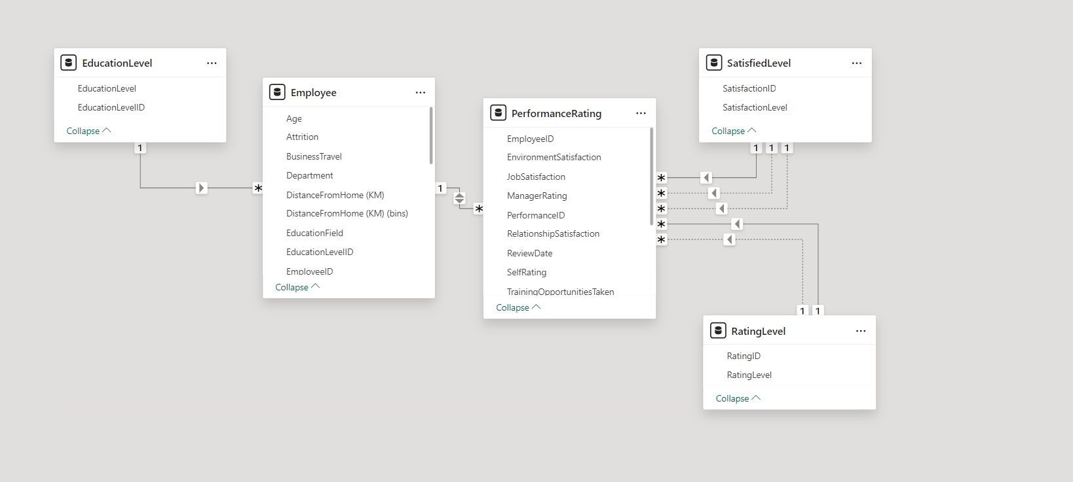
Data Modeling
The dataset include 5 tables :
Data Relationship Setup:
1. the tables are related through primary keys.
- EmployeeID connects the Employee & Performance Rating tables.
- SatisfactionID, RelationshipSatisfaction , EnvironmentSatisfaction &
JobSatisfaction connects Performance Rating & Satisfied Level tables
- RatingID , SelfRating, & ManagerRating connects Performance Rating
& Rating Level tables
- EducationLevelID connects the Employee & Education Level tables

Slide 10

Data Analysis Questions
1
Attrition-related
2
Performance-related
3
Demographics-related
4
Travel and Job Role

Slide 11
Employee Attrition Analysis KPIS - Main Dashboard
KPIS | Description | insights
Headcount | Total number of employees | 1470
Onboard | Number of current employees | 1233
Exits | Employees who have left | 237
Retention % | Overall workforce stability | 83.8%
Attrition % | Overall workforce stability | 16.12%

Slide 12
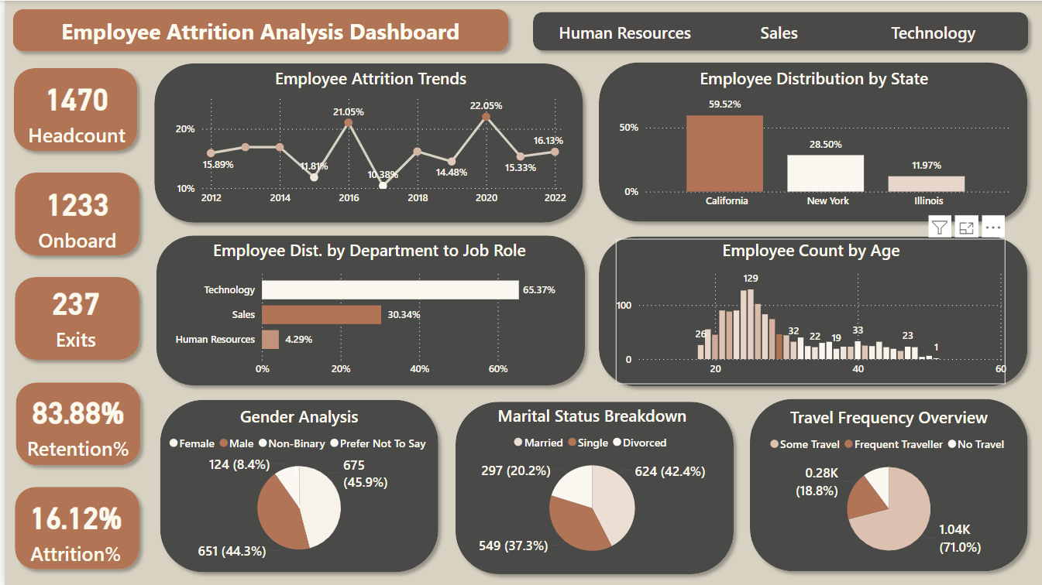

Key Insights from Employee Attrition Dashboard
The current attrition rate is 16.12%, with the highest turnover recorded in 2020.
Most employees are located in California 59.52% from total employees , which also has the highest turnover rate among state 17.49% .
Although the Technology department has the largest number of employees, the Sales team has the highest attrition rate at 20.63%, specifically among Sales Representatives.
Employees aged 29 experience the highest attrition rate.
Single employees have the highest attrition rate, which is reasonable considering their younger age demographic.
Employees who travel frequently exhibit the highest attrition rate compared to other travel categories.

Slide 13
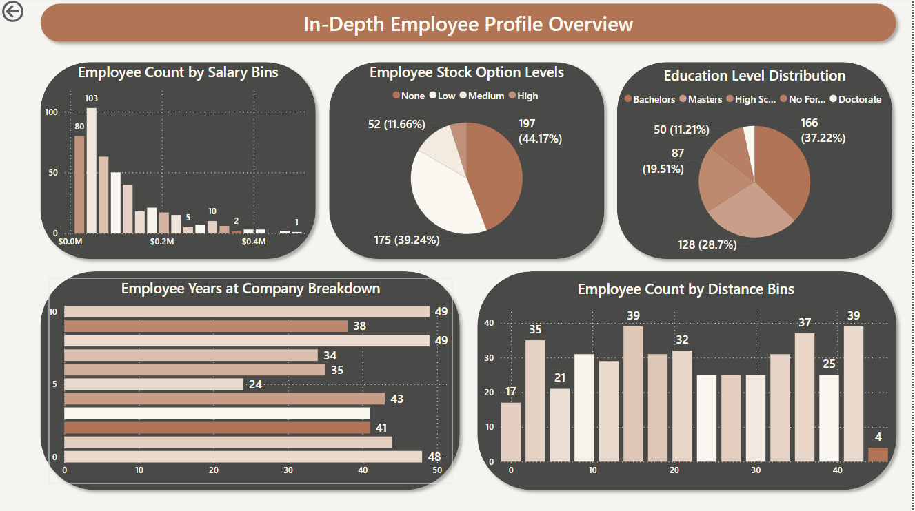

Key insights from In Depth profile overview
Employee Distance : California's high attrition rate is influenced by long employee commutes, with an average distance of 26 miles.
Salary Impact : Sales Representatives have the highest attrition rate, likely due to lower salary levels .
Marital Status : Single employees show the highest attrition, driven by lower salaries and fewer qualifications.
Employees with none stock option level show the highest attrition

Slide 14
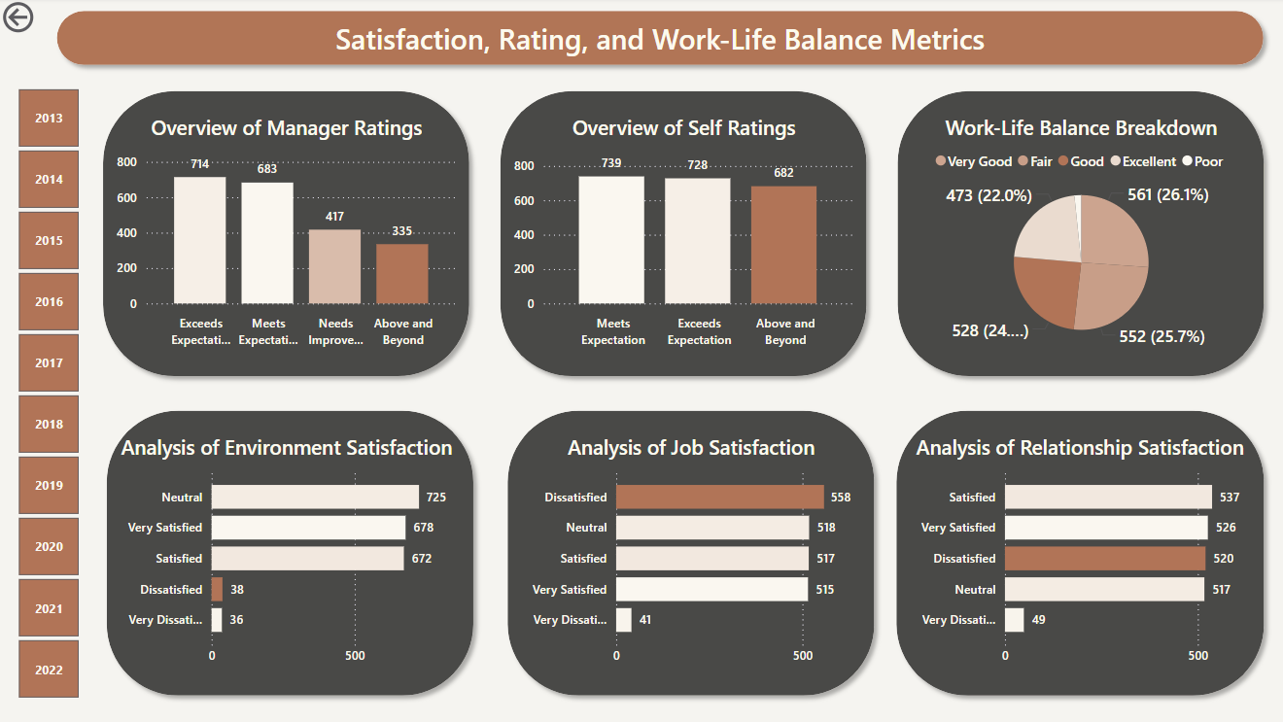

Key insights Satisfaction, Rating, and Work-Life Balance Metrics
A low manager rating correlates with a higher attrition rate.
Job dissatisfaction is associated with an increased attrition rate.
Dissatisfaction in workplace relationships leads to the highest attrition rate .
Work-life balance has no significant impact on attrition rates.

Slide 15
Conclusion
Based on the insights from the employee attrition analysis dashboards, here are some key conclusions:
Attrition is a significant issue: The organization is experiencing a relatively high attrition rate, particularly in certain departments and among specific employee groups.
Multiple factors contribute to attrition: Several factors are influencing employee turnover, including low manager ratings, job dissatisfaction, workplace relationship issues, long commutes, and compensation levels.
Targeted interventions are necessary: To effectively address attrition, the organization should implement targeted strategies to improve manager effectiveness, enhance job satisfaction, foster a positive workplace culture, address commuting challenges, and ensure fair compensation.
Continuous monitoring and analysis: Regular monitoring and analysis of employee attrition data are crucial for identifying emerging trends and evaluating the effectiveness of implemented strategies.

Slide 16
Recommendations
Prioritize manager development: Invest in training programs to improve managerial skills and create a more supportive work environment.
Enhance employee engagement: Implement initiatives to boost job satisfaction and employee engagement, such as recognition programs, career development opportunities, and flexible work arrangements.
Improve workplace culture: Foster a positive and inclusive workplace culture that promotes collaboration, communication, and respect.
Address commuting challenges: Explore options to reduce the impact of long commutes, such as flexible work arrangements, transportation benefits, or relocating offices to more accessible locations.
Review compensation practices: Conduct a thorough review of compensation levels and ensure that employees are fairly rewarded for their contributions.
By implementing these recommendations, the organization can significantly reduce employee attrition and create a more positive and productive work environment.

Slide 17

THAK YOU

